Slide 1
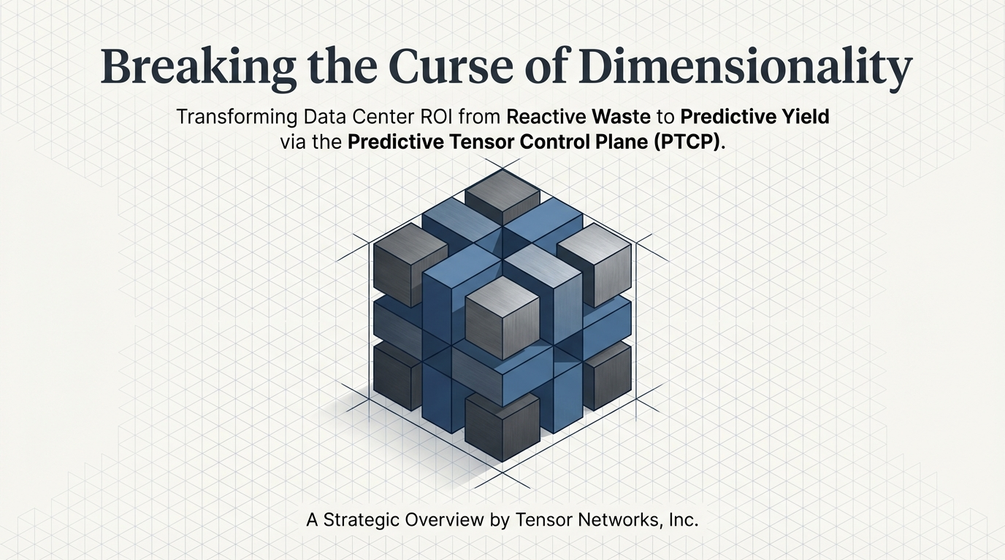

2026 Tensor Networks, Inc. All Rights Reserve red. www.tensornetworks.ai

Slide 2
Disclaimer: Forward-Looking Statements This presentation may contain forward-looking statements regarding future product plans, expected features, or anticipated release dates.
These statements outline our general product direction and should not be relied upon in making purchasing decisions. The development, release, and timing of any features or functionality described for our products remain at our sole discretion and are subject to change without notice. These statements do not represent a commitment, promise, or legal obligation to deliver any specific material, code, or functionality
2026 Tensor Networks, Inc. All Rights Reserve red. www.tensornetworks.ai

Slide 3
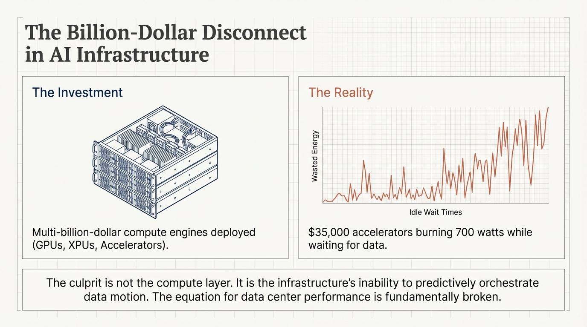
2026 Tensor Networks, Inc. All Rights Reserve red. www.tensornetworks.ai

Slide 4
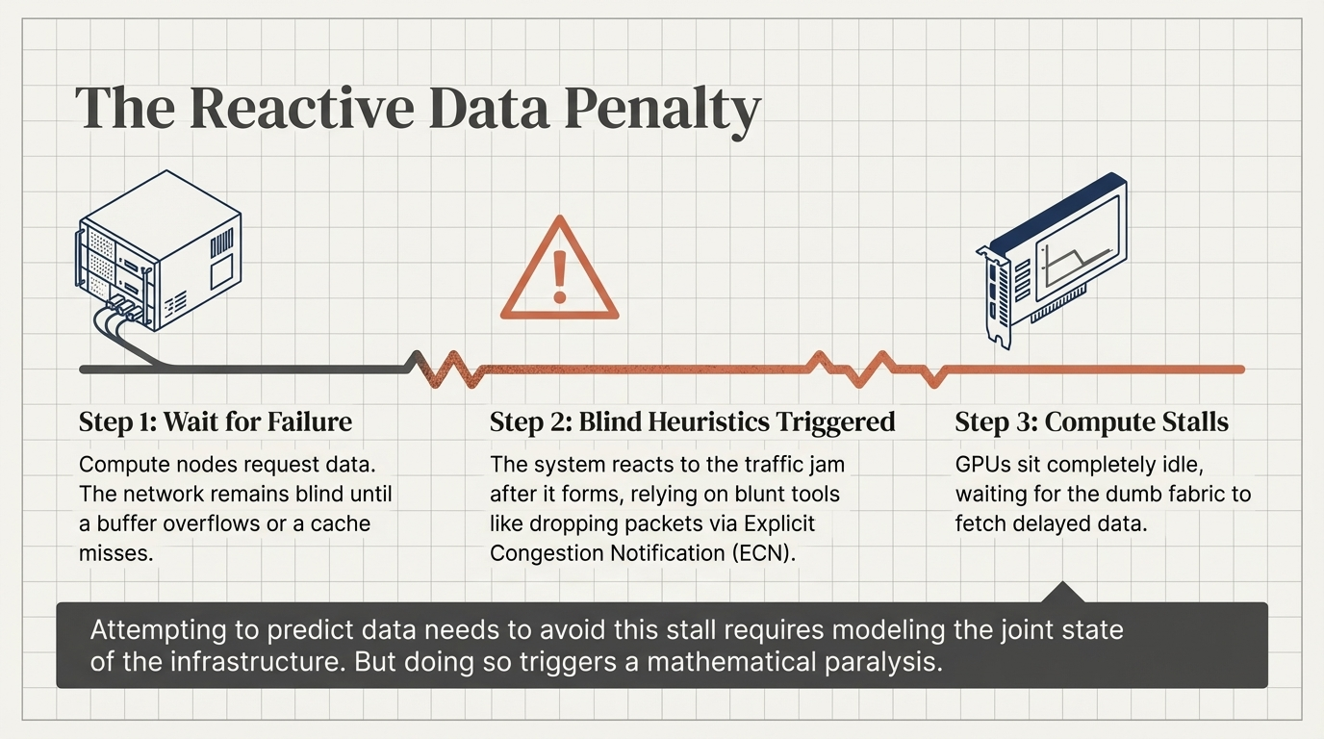
2026 Tensor Networks, Inc. All Rights Reserve red. www.tensornetworks.ai

Slide 5
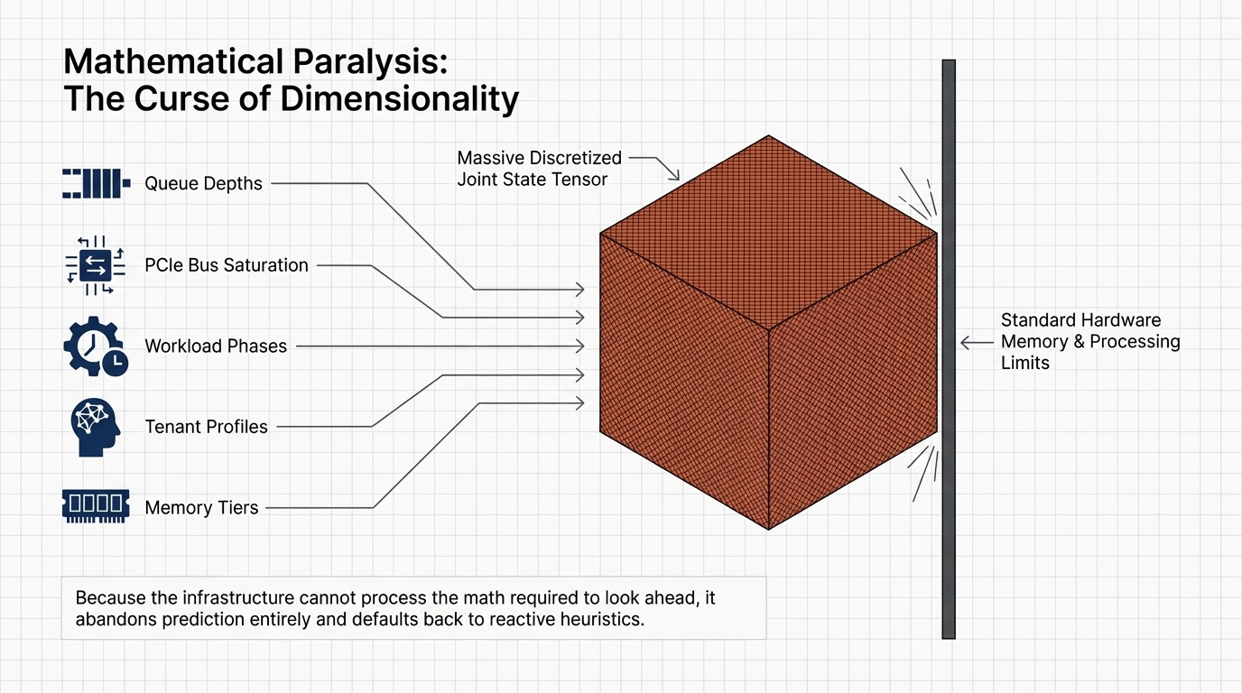
2026 Tensor Networks, Inc. All Rights Reserve red. www.tensornetworks.ai

Slide 6
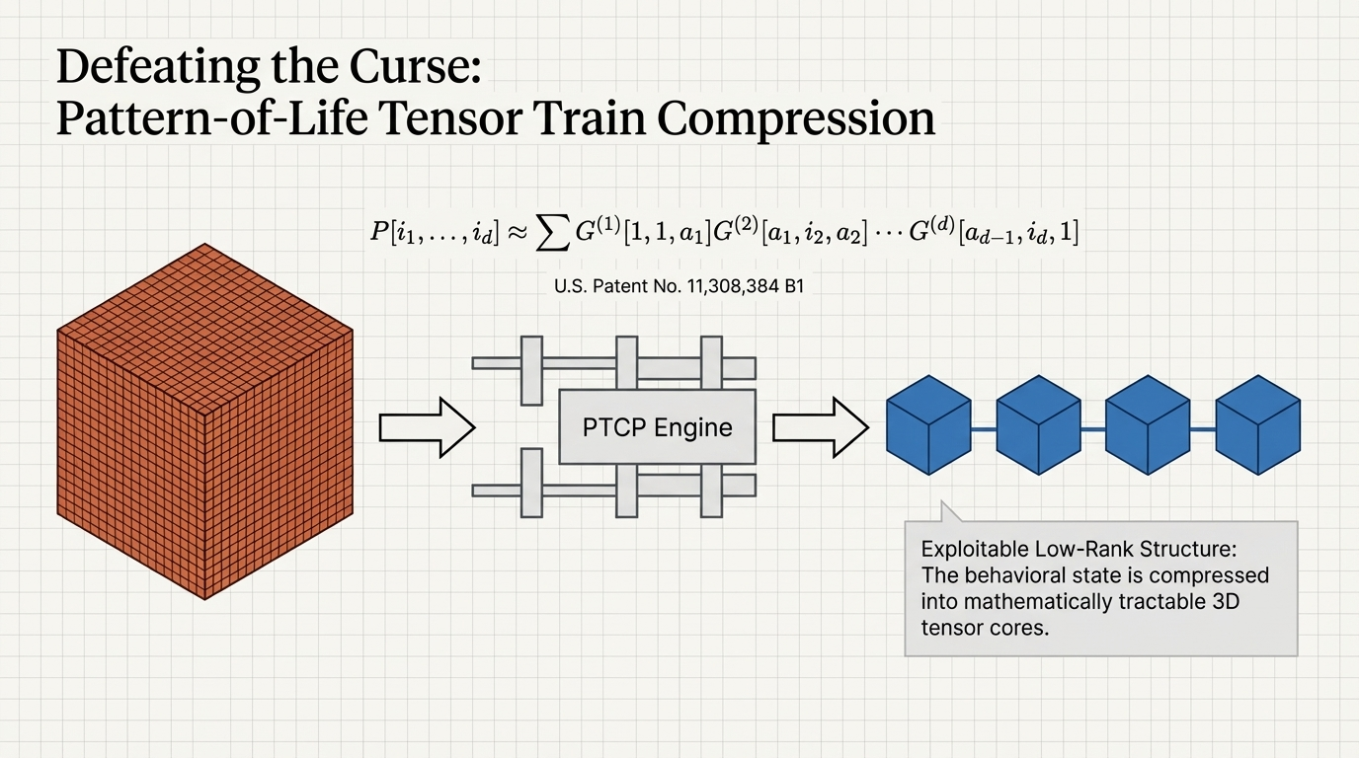
2026 Tensor Networks, Inc. All Rights Reserve red. www.tensornetworks.ai

Slide 7
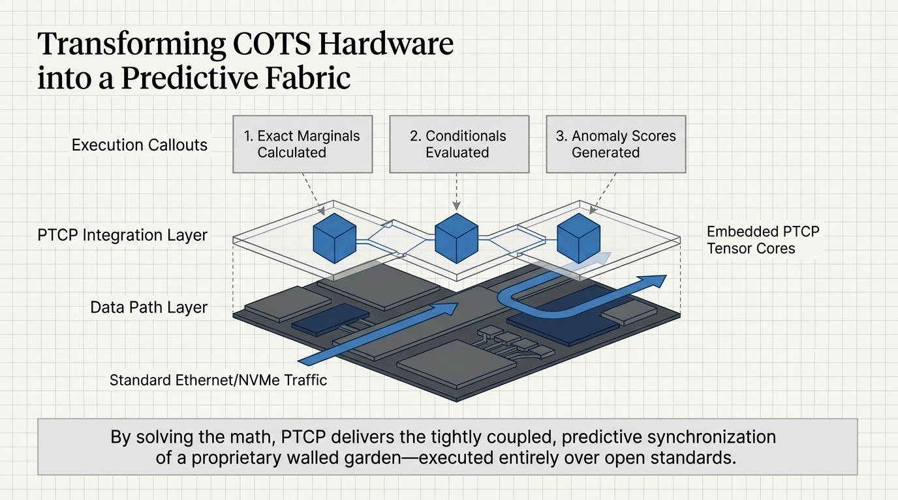
2026 Tensor Networks, Inc. All Rights Reserve red. www.tensornetworks.ai

Slide 8
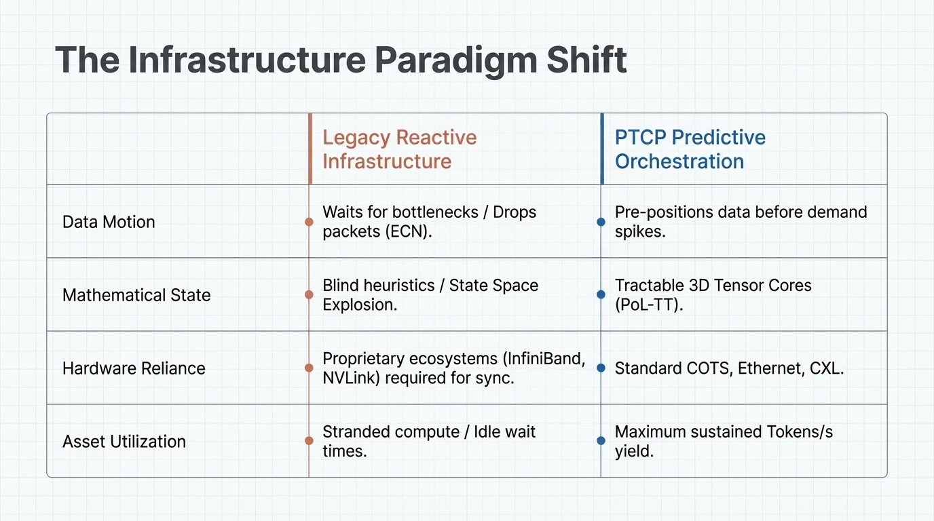
2026 Tensor Networks, Inc. All Rights Reserve red. www.tensornetworks.ai

Slide 9
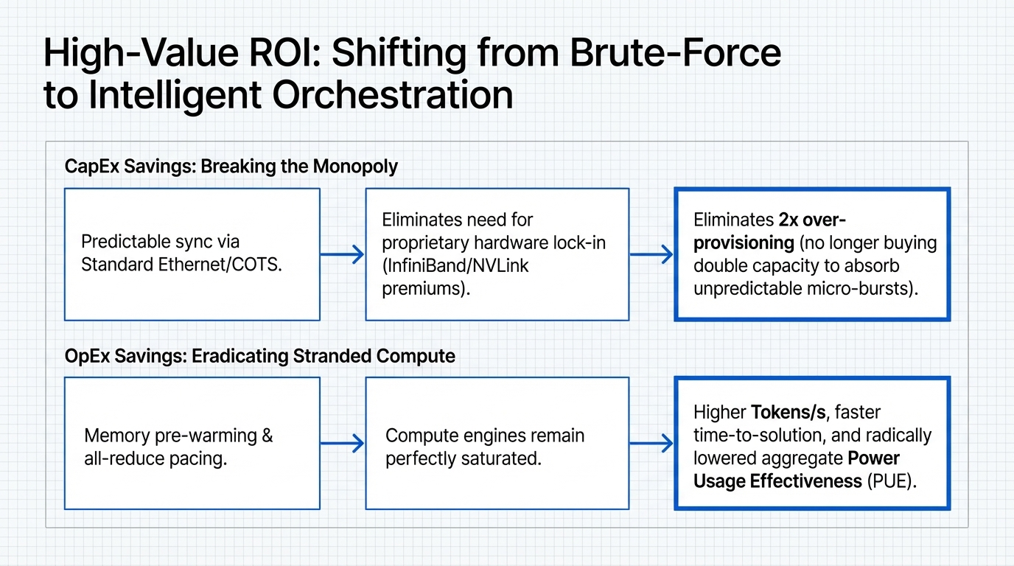
2026 Tensor Networks, Inc. All Rights Reserve red. www.tensornetworks.ai

Slide 10
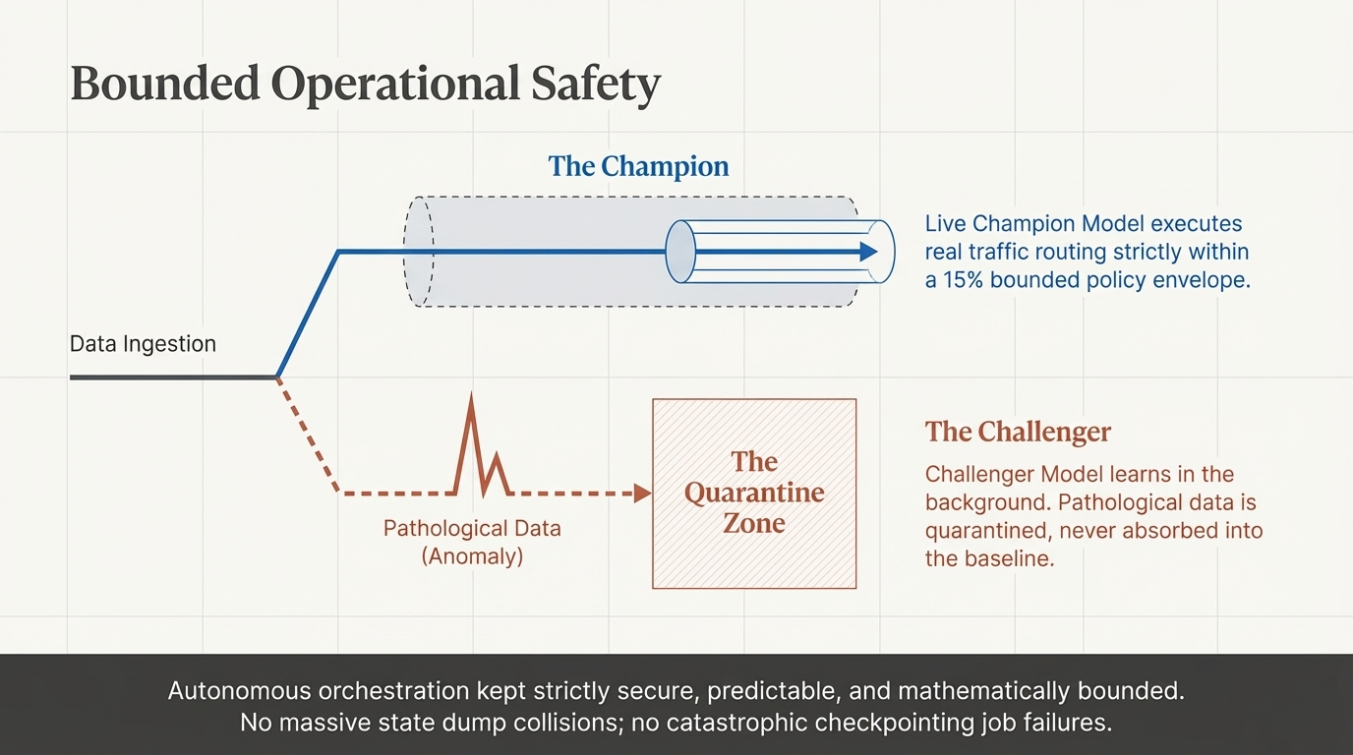

Slide 11
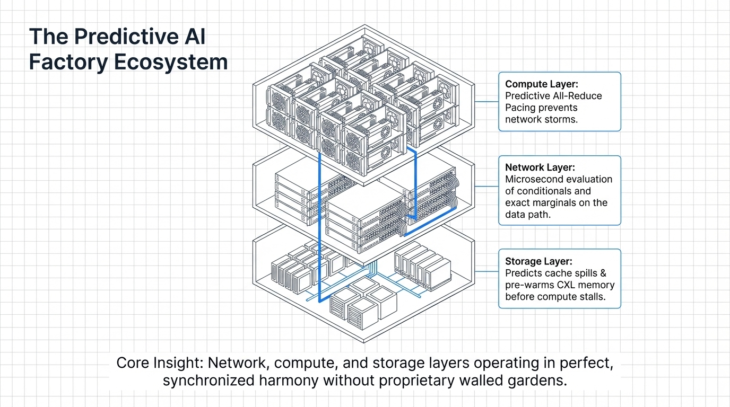
2026 Tensor Networks, Inc. All Rights Reserve red. www.tensornetworks.ai

Slide 12
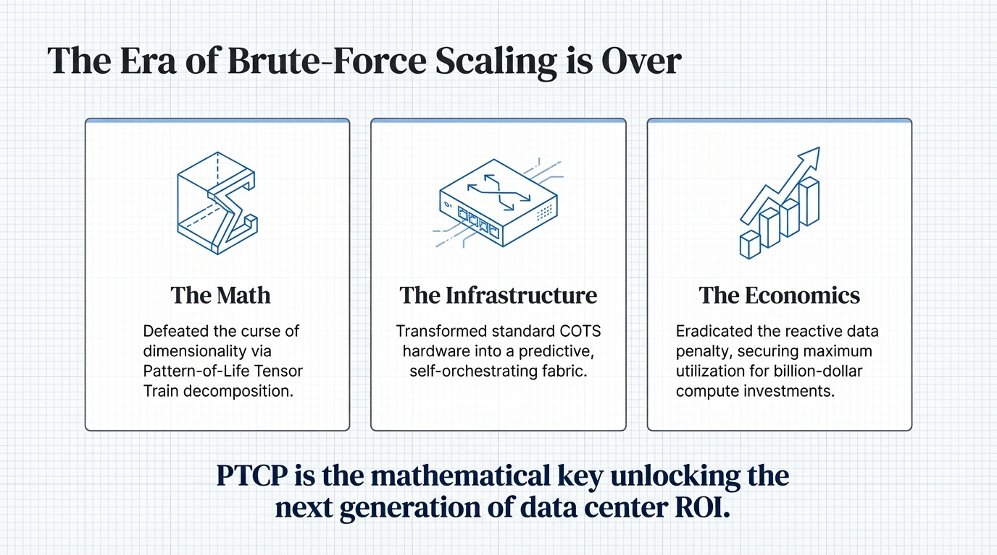
2026 Tensor Networks, Inc. All Rights Reserve red. www.tensornetworks.ai

Slide 13
Thank You for Your Partnership We look forward to building the future of networking together. Please don't hesitate to reach out with any questions.
Tensor Networks, Inc. Contact Us: information@tensornetworks.net
2026 Tensor Networks, Inc. All Rights Reserve red. www.tensornetworks.ai

